Slide 1
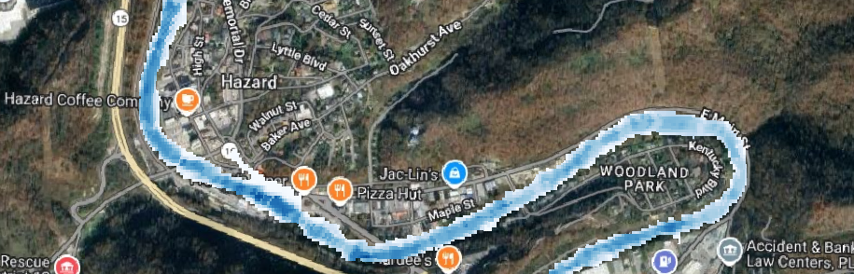
Using Streamflow Forecasts to Produce Flood Impact Forecasts
Joseph Gutenson, PhD¹ and Mike Follum, PE, PhD¹
With contributions from E. James Nelson, PhD²; Riley C. Hales, PhD^{1,2}; L. Richardo Rosas²; Pitamber Wagle²; James Halgren, PhD²; Brian Maughan²; Snigdha Nautiyal³; Apoorva Joshi³
¹Follum Hydrologic Solutions, Casper, WY
²Brigham Young University, Provo, UT
³University of Minnesota, Minneapolis, MN
CIROH DevCon, May 27th, 2026, University of Utah

Slide 2
Prerequisites
BEFORE attending our workshop on May 27th, please make sure to install NenCarta using the instructions found on the GitHub README file at https://github.com/jlgutenson/nencarta.
BEFORE attending, please download the test data at: https://drive.google.com/drive/folders/1tnp8eFu44VGlXeuq26kA-Sz_t6CsEZTr?usp=sharing
If you are unable to access the GitHub repository or test data at the links above, please email joseph@follumhydro.com.

Slide 3

Objectives
Develop an understanding of how modern streamflow forecasting and informatics can be used to anticipate the economic impacts of flooding on the built environment.
Learn one process of transforming streamflow forecasts into flood-inundation maps to better assess potential impacts on communities and infrastructure.
Gain hands-on experience with a practical workflow that converts streamflow predictions into building-level flood-impact forecasts.
Explore how integrated tools for inundation mapping and impact assessment can be applied across the continental United States to estimate potential flood damages.

Slide 4
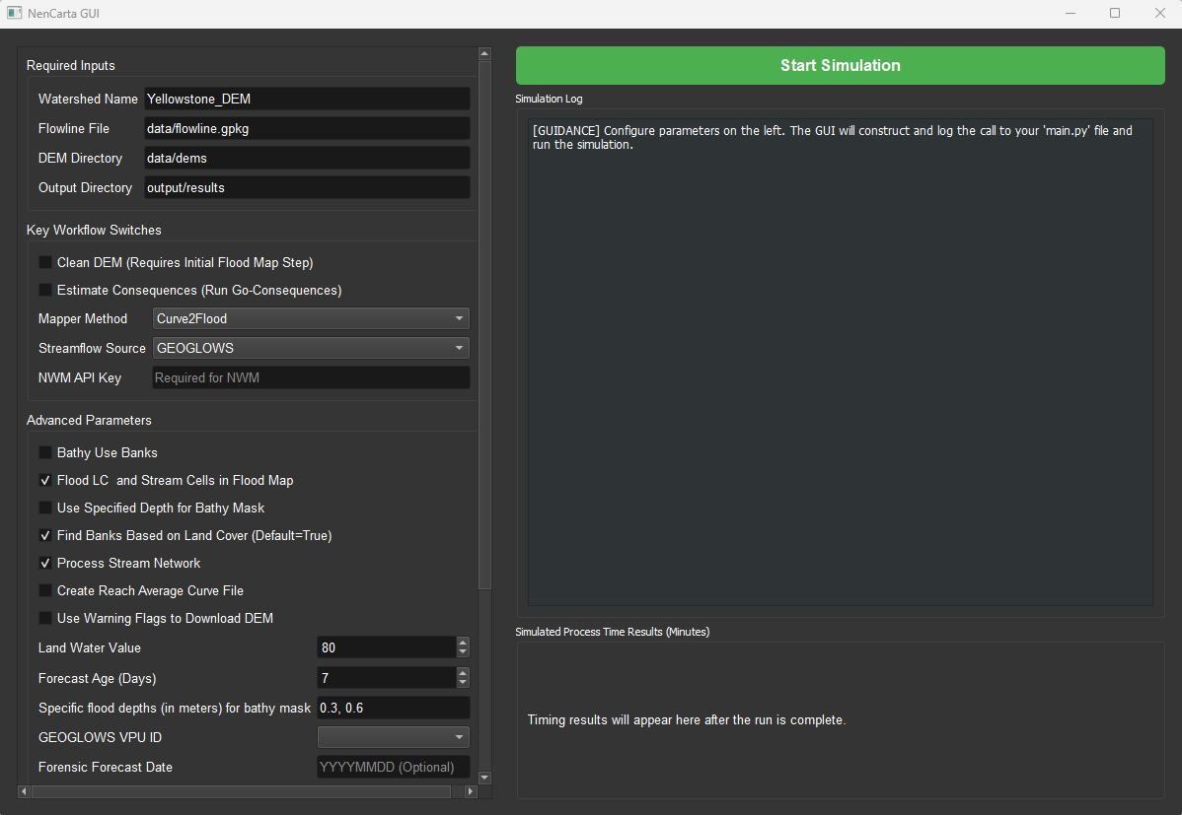
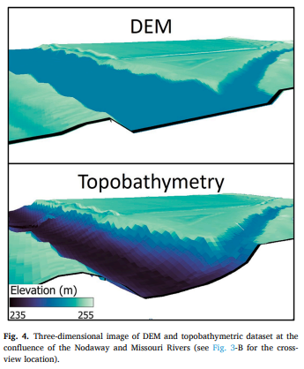
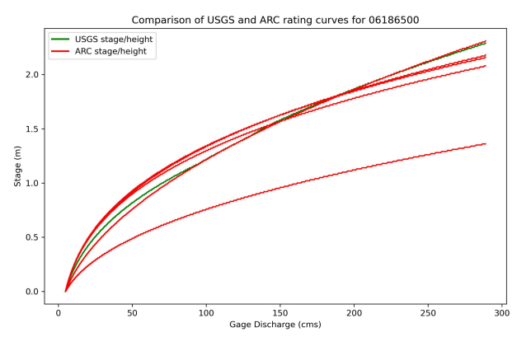
How To Produce Flood Inundation From Streamflow Forecasts
(Before The Forecast)
Inputs are 1) DEM data, 2) GEOGLOWS or NWM flowlines.
Simulations can occur either in terminal or by using a built-in graphical user interface (GUI).
Optionally, flowlines from GEOGLOWS or NWM can be conflated to match the DEM we are using (we will be doing this).
Flowlines are rasterized and each cell where a stream is present is considered a stream cell.
For each stream cell, NenCarta estimates many cross-sections, estimates a bathymetry, and builds a rating curve library and database of velocity, depth, and top-width values (VDT Database) for each stream cell at different streamflow magnitudes.
Bathymetry from cross-sections is burned into the DEM.
WorldCover 2021 is used for roughness coefficient estimates used in hydraulic calculations.

Slide 5
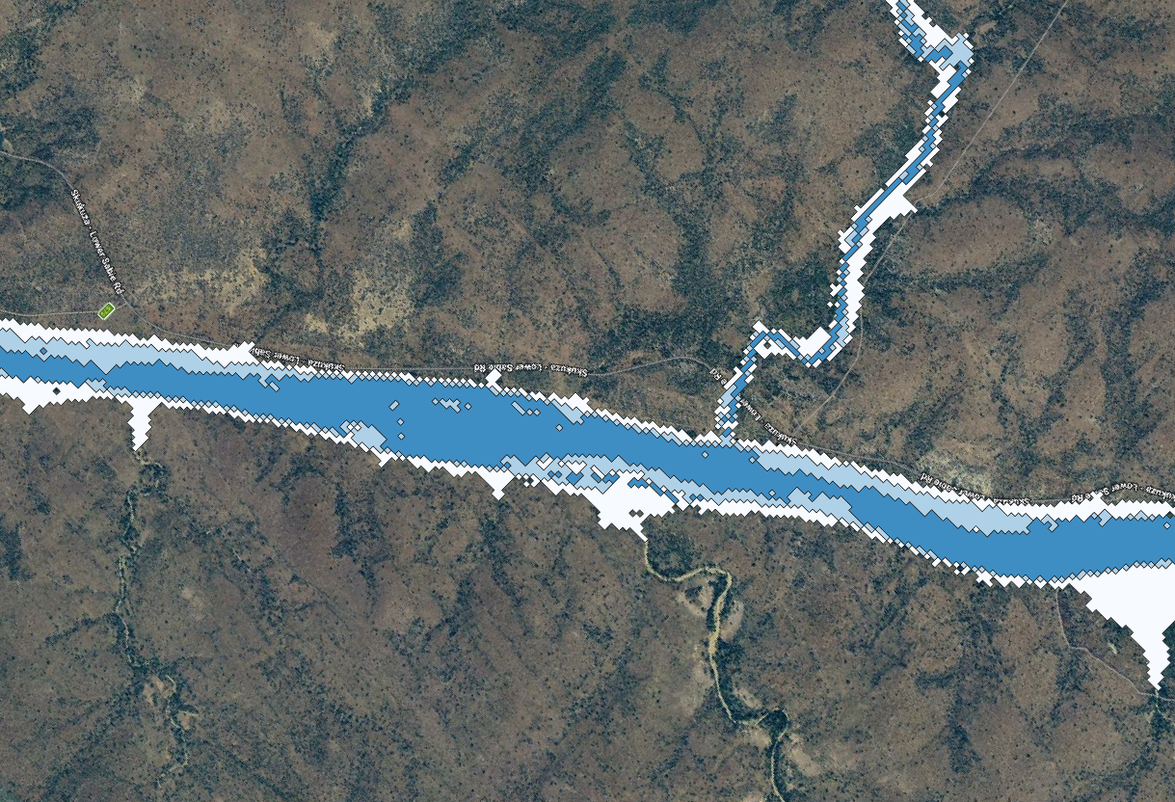
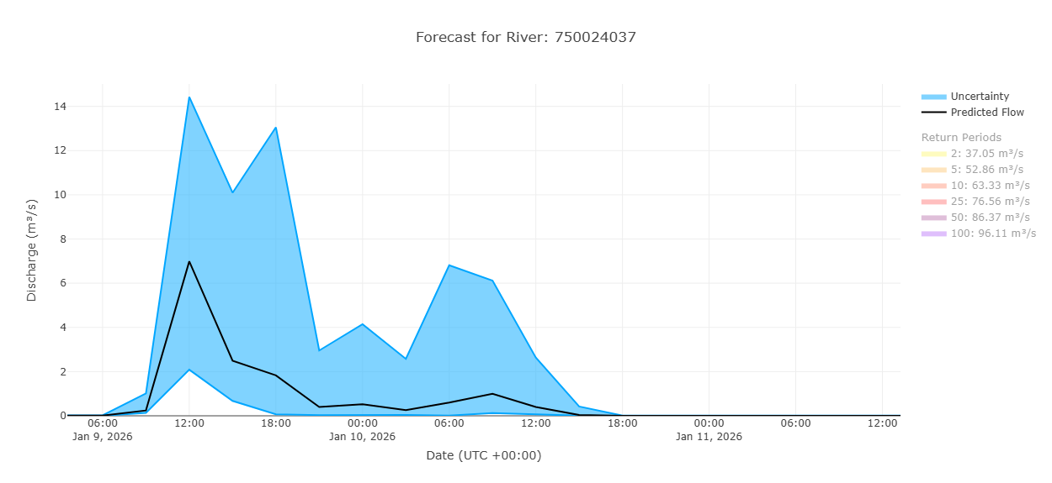
How To Produce Flood Inundation From Streamflow Forecasts
(The Forecast)
The DEM with burned bathymetry and the rating curve or VDT database are then paired with the NWM or GEOGLOWS forecast to estimate probabilistic FIM.
When the streamflow forecast is an ensemble, we make use of the forecast peaks of each ensemble member in the streamflow forecast.
Currently for all ensemble members of streamflow, we find the forecast peak and then estimate the minimum, median, and maximum forecast peak.
These forecast peaks are used to estimate hydraulic variables like depth, velocity, and top-width by query the rating curves or VDT Database.
A FIM is estimated for the minimum, median, and maximum ensemble peaks of streamflow forecasts and they are then combined.
+
+
=
NOTE: We will be using the VDT Database when performing flood inundation mapping in this tutorial

Slide 6

How Ensemble Flood Maps are Produced and Interpreted
(The Interpretation (Currently))
The ensemble output geospatial data will contain three values:
  33 => maximum streamflow peak from ensemble predicts flooding here
  66 => median and maximum streamflow peak from ensemble predicts flooding here
  100 => minimum, median, and maximum streamflow peak from ensemble predicts flooding here
The highest chance of flooding reflects maximum ensemble agreement, and less chance of flooding reflects low ensemble agreement.
NenCarta can be altered to use more or less ensemble members to create a similar map.
This map gives us an idea of the potential breadth of flooding, given the weather forecast uncertainty.
A maximum depth raster is also created that we will use to assess flood consequences
    Example of the ensemble flood inundation map from an ensemble streamflow forecast

Slide 7
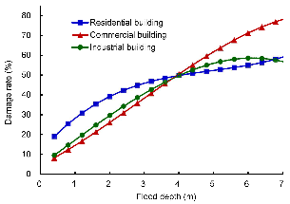
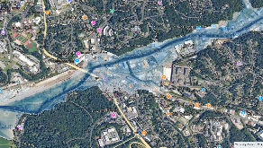

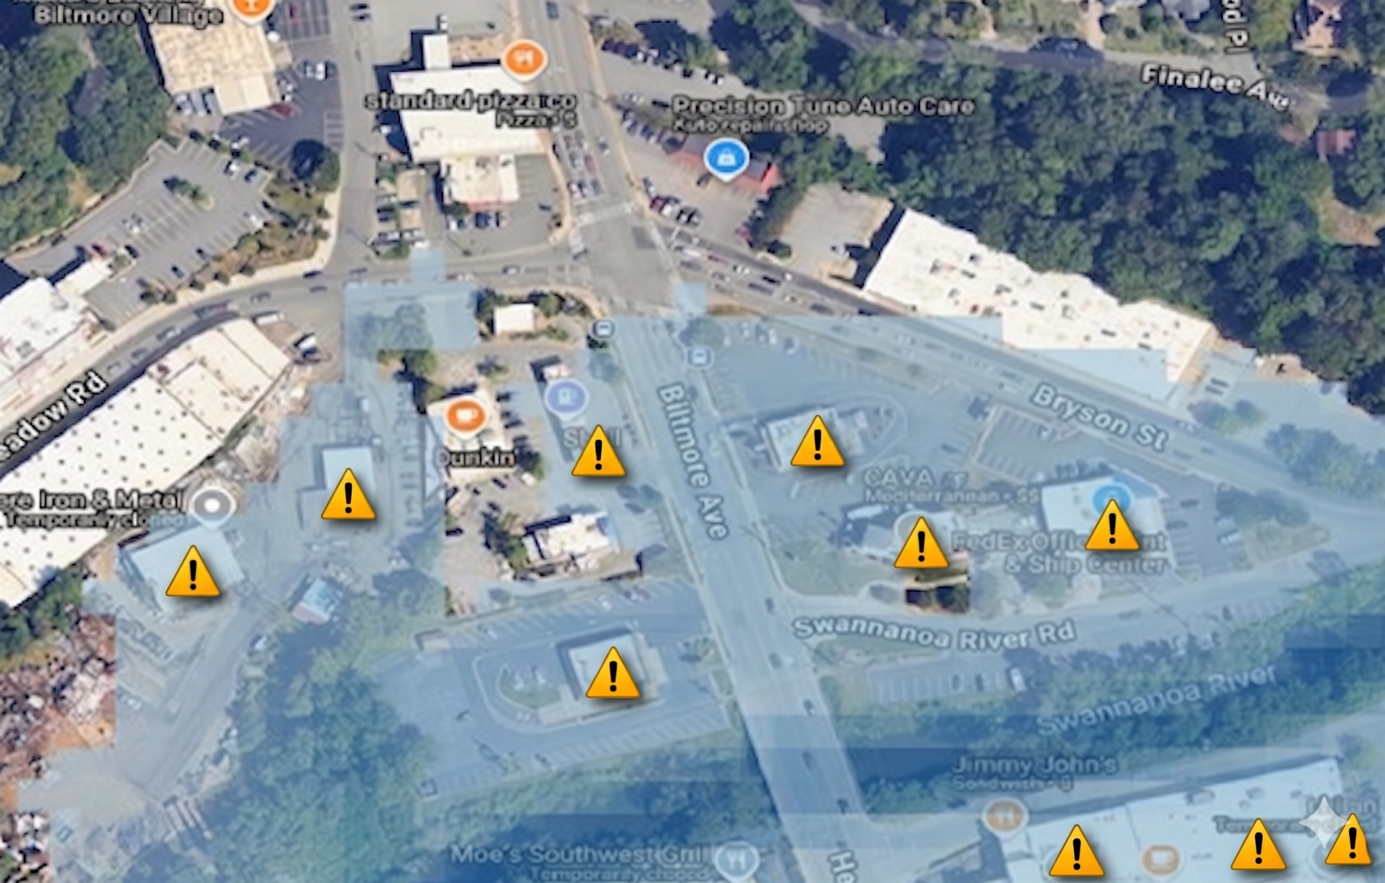
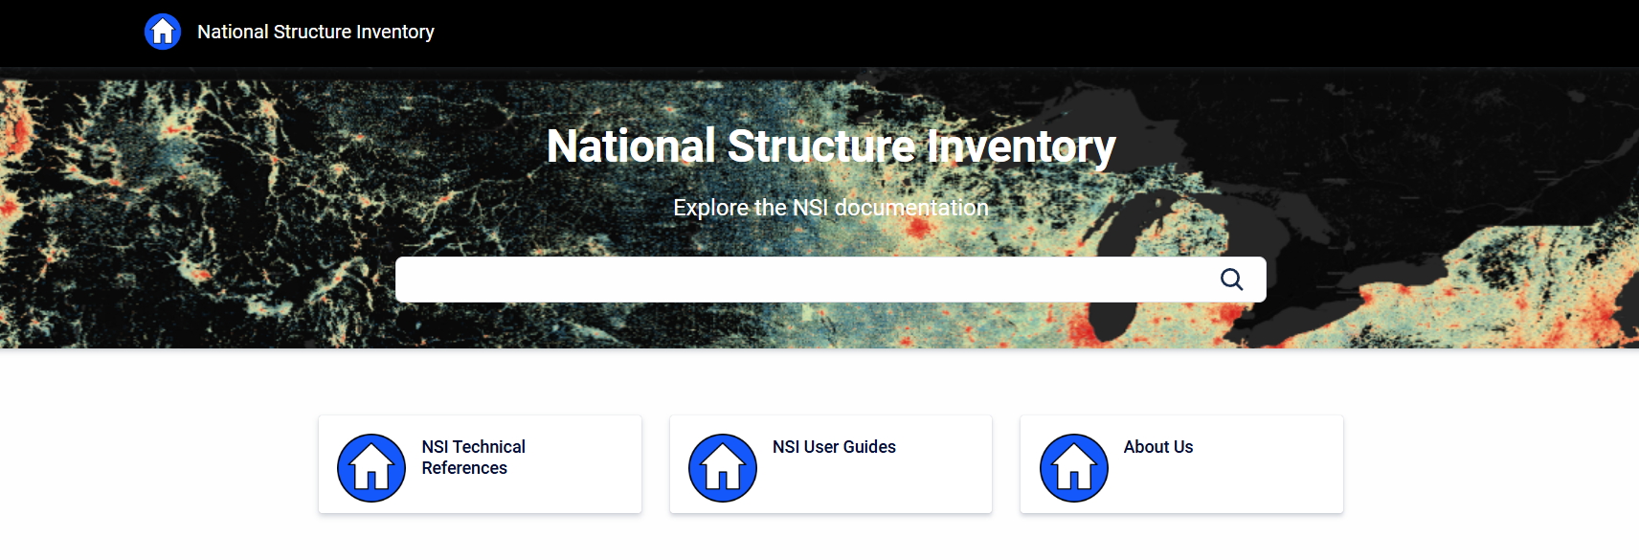
Converting Streamflow Forecasts into Building-Level Flood-Impact Forecasts
(Process Overview)
Go-consequences as consequence model (https://github.com/USACE/go-consequences)
Generated Single Flood Depth Grid
(Currently maximum forecast from ensemble)
Input Multiple Streamflow Forecasts
National Structure Inventory provide data on buildings and occupancy for CONUS (https://www.hec.usace.army.mil/confluence/nsi)
Point level flood damage

Slide 8
Converting Streamflow Forecasts into Building-Level Flood-Impact Forecasts
(An Example)
Here is a breakdown of the relevant fields in the flood damage forecast output geopackage:
fd_id = NSI unique identifier
depth = Depth of water at the building location that was found in the provided flood depth grid.
damage cat = Damage category of the building. Damage categories are a larger aggregation than occupancy type (e.g., Residential, Commercial, Industrial, or Public).
occupancy = Damage Function or Occupancy Type of the building. This field relates the building’s depth-damage relationships, number of stories, number of households, and other generic characteristics to the structure location.
structure = The dollars of economic damage estimated for the building’s structure. This is based upon the depreciated replacement value of the building’s structure, not the financial replacement value or how much it would cost to actually rebuild the structure.
content da = The dollars of damage to the contents of the building, such as furniture and clothing.
pop2amu65 = Population at night for the building of people under the age of 65.
pop2amo65 = Population at night for the building of people over the age of 65.
pop2pmu65 = Population during the day for the building of people under the age of 65.
pop2pmo65 = Population during the day for the building of people over the age of 65.
s_dam_per = the percent of damage to the structure of the building estimated using the assigned depth-damage function.
c_dam_per = the percent of damage to the contents of the building estimated using the assigned depth-damage function.
cbfips = The Census block that the structure exists in.
Population data was indexed to 2020 levels and prices were indexed to 2021.
Depth and Damage Estimates

Slide 9
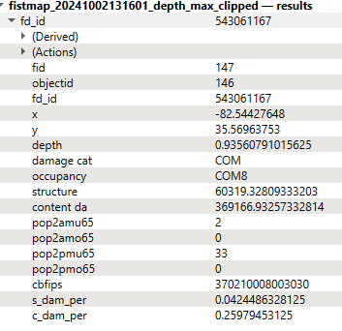
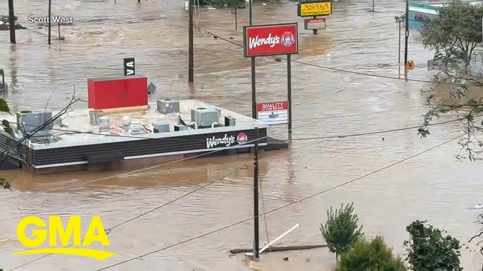
Converting Streamflow Forecasts into Building-Level Flood-Impact Forecasts
(An Example)
Depth and Damage Estimates
The attribute table in your flood damage geopackage will look something like the one to the right.
So, in this instance, NenCarta’s flood map estimated, in 2021 dollars, $60,319.33 in structural economic (depreciated) damage, $369,166.93 in content economic (depreciated) damage would be incurred to the Asheville Wendy’s.

Slide 10
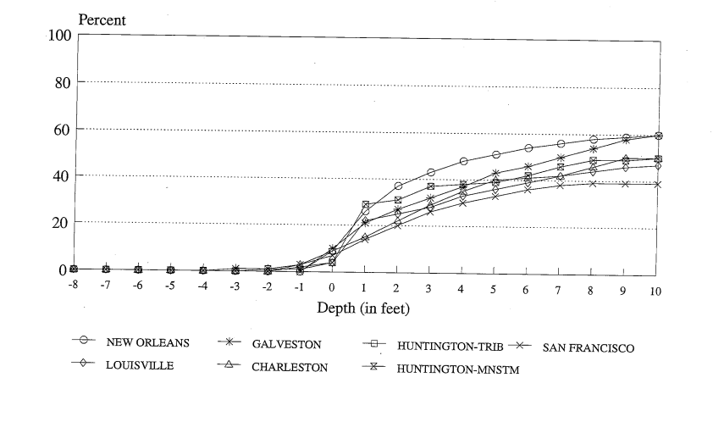
Converting Streamflow Forecasts into Building-Level Flood-Impact Forecasts
(How it Works)
1.
Depth and Damage Estimates
If depth is present, the foundation height of the structure is subtracted from the depth to create depth above finished floor elevation.
The proper damage function is queried from the damage function family for contents and structures.
The resulting damage percentage value is converted from a percent to a decimal by dividing by 100 and then is applied to structure and content values accordingly.
This is the occupancy type, it used for depth damage function selection
COM8 = Entertainment or Recreational Use
2.
3.
https://github.com/USACE/go-consequences/wiki/Direct-Structure-Losses
Depth-Damage Function

Slide 11
Converting Streamflow Forecasts into Building-Level Flood-Impact Forecasts
(How it Works)
1.
Depth and Damage Estimates
If depth is present, the foundation height of the structure is subtracted from the depth to create depth above finished floor elevation.
The proper damage function is queried from the damage function family for contents and structures.
The resulting damage percentage value is converted from a percent to a decimal by dividing by 100 and then is applied to structure and content values accordingly.
structure= 1420995.78 (2021 structure value in NSI) * s_dam_per
2.
3.
https://github.com/USACE/go-consequences/wiki/Direct-Structure-Losses
Depth-Damage Function

Slide 12
Converting Streamflow Forecasts into Building-Level Flood-Impact Forecasts
(How it Works)
1.
Depth and Damage Estimates
If depth is present, the foundation height of the structure is subtracted from the depth to create depth above finished floor elevation.
The proper damage function is queried from the damage function family for contents and structures.
The resulting damage percentage value is converted from a percent to a decimal by dividing by 100 and then is applied to structure and content values accordingly.
content da = 1420995.78 (2021 content value in NSI) * s_dam_per
2.
3.
https://github.com/USACE/go-consequences/wiki/Direct-Structure-Losses
Depth-Damage Function

Slide 13
Let's Get Hands-On with NenCarta!
Remember that you need to get NenCarta installed using the instructions of GitHub: https://github.com/jlgutenson/nencarta
Remember to download the test data to your local machine from this link: Link to Test Data: https://drive.google.com/drive/folders/1tnp8eFu44VGlXeuq26kA-Sz_t6CsEZTr?usp=sharing
Open a command-prompt or terminal to run conda.
Make sure the conda environment you set up at step 1 is active (conda activate nencarta_py312).
Make sure Docker Desktop is running on your machine.
Enter “flood-mapping gui” as a command in your command-prompt or terminal window.
The NenCarta graphical user interface (GUI) should now be available for you to create your NenCarta inputs and run NenCarta.
Enter the GUI inputs as provided on the next few slides.

Slide 14
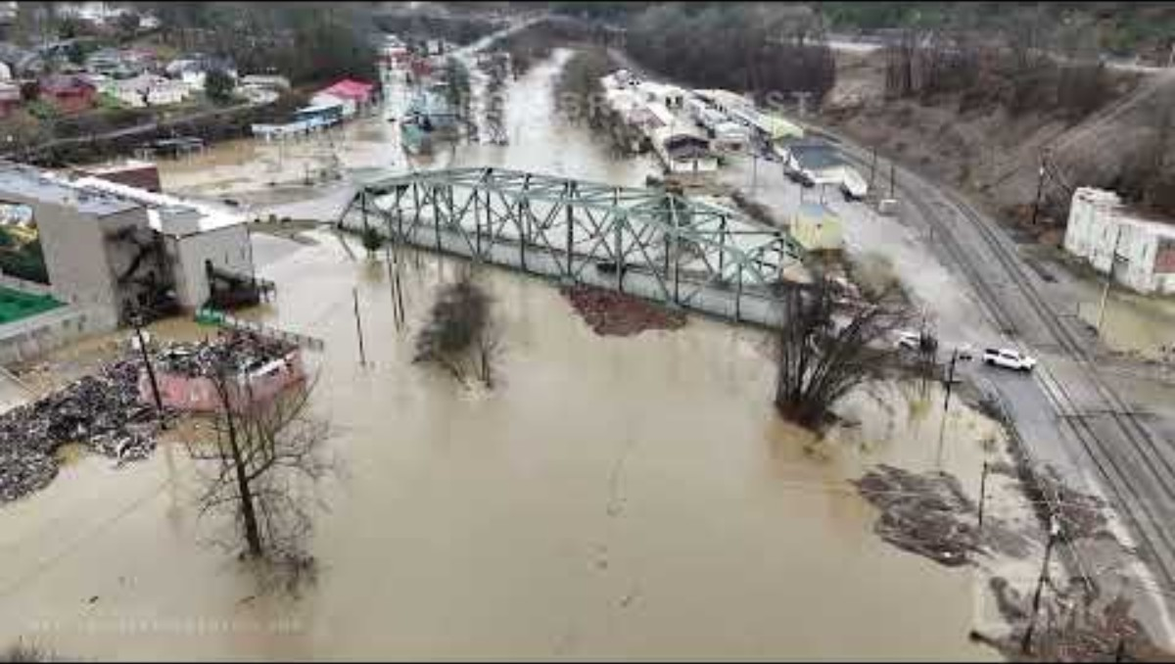
Let's Get Hands-On with NenCarta!
Test Case will focus on the February 2025 floods in eastern Kentucky

Slide 15
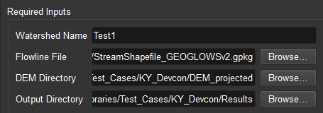
Let's Get Hands-On with NenCarta!
Watershed Name: This will be the unique name for the project you are running and will be the name of the output file that is stored within the Output Directory. All NenCarta outputs will be stored in this folder.
Flowline File: This will be a path to the flowline data you will use to simulate flood inundation with NenCarta. Currently, this must be a geopackage of either the GEOGLOWS version 2 flowlines or NHDPlus version 2, that the current operational National Water Model (NWM) uses. Use the "Browse..." button to ensure / are used instead of \. This data was provided in the test dataset you downloaded.
DEM Directory: This will be a path the directory containing the DEM tif files that you will be using to simulate flood inundation. Use the "Browse..." button to ensure / are used instead of \. This data was provided in the test dataset you downloaded.
Output Directory: The path to where the NenCarta output will be stored. The output will be stored here in a subfolder that is what you specified in Watershed Name. Use the "Browse..." button to ensure / are used instead of \.

Slide 16
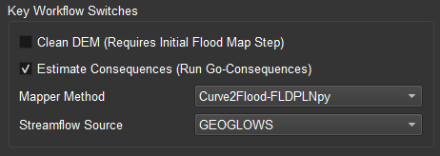
Let's Get Hands-On with NenCarta!
Clean DEM: Checking this box indicates that you want to run what we call the DEM Cleaner, which will work to establish a continuous, monotonically sloping stream within the DEM, that has a flat bottom.
Estimate Consequences: Checking this box indicates that you want to use the National Structure Inventory and Go-Consequences to estimate the direct impact of the flood on the local buildings. This option currently only works within the Continental United States (CONUS).
Mapper Method: This dropdown allows you to select which flood mapping technique will be used to perform bathymetry estimation and flood mapping. The current operational options both reside within the Curve2Flood software and include "FloodSpreader", "Curve2Flood-Kernel Weighted", or "Curve2Flood-FLDPLNpy", or "Curve2Flood-Multi-Point Interpolation".
Streamflow Source: This dropdown allows you to select which streamflow source you will use as reanalysis data and forecast data to simulate your Automated Rating Curve (ARC) model and your chosen Mapper Method. Your options are GEOGLOWS forecast or the short-, medium-, or long-range National Water Model (NWM) forecast.
NWM API Key: NenCarta uses the NWM Big Query API to access NWM streamflow data. This data source requires an API. You must submit an API request using this link: https://hub.ciroh.org/docs/products/data-management/bigquery-api/. Once the CIROH team provides you an API key, you can add that key to this field to access NWM streamflow datasets.
Note: Use the parameters in the image.

Slide 17
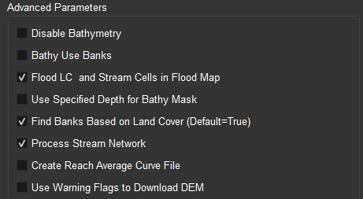
Let's Get Hands-On with NenCarta!
Disable Bathymetry: Checking this box will disable the estimation of bathymetry within the hydraulic calculations and the creation of a composite topobathymetric surface.
Bathy Use Banks: Checking this box indicates that you want ARC to use the elevation of the banks to estimate bathymetry instead of using the water surface elevation in the DEM. Checking this box indicates that you want to specify and channel forming discharge in your Bathy Flow Field. Not checking this box indicates you want to use a baseflow in your Bathy Flow Field. See ARC's wiki for more information: https://github.com/MikeFHS/automated-rating-curve/wiki/Estimating-Bathymetry-in-ARC
Flood LC and Stream Cells in Flood Map: Checking this box indicates that you want to ensure that the water in the land cover data is added to your flood inundation map.
Use Specified Depth for Bathy Mask: Checking this box indicates that you want to create your water mask that will be used for bathymetry by using a specific depth of water to map with your Flood Mapper option you selected. This should be used in tandem with Specific flood depths (in meters) for bathy mask.
Find Banks Based on Land Cover: Checking this box indicates that you want ARC to use land cover as your first option when determining where the banks of the streams are for bathymetry estimation. Otherwise, ARC will first assume that the cross-section contains a flat what surface and will first try to find the banks by finding when the elevation increases in the cross-section.
Process Stream Network: Checking this box indicates that you want NenCarta to process the flowline network and DEM you have provided to create the inputs for ARC and your selected Flood Mapper. For instance, the stream network will be rasterized, if this option is selected.
Create Reach Average Curve File: Checking this box indicates that you want ARC's curvefile output to be an averaged for each stream reach in your modeling domain. This will make the curve parameters the same for all stream cells that share the same unique ID.
Use Warning Flags to Download DEM: This option only works when using GEOGLOWS as your streamflow source and works in tandem with your specified GEOGLOWS VPU ID. When this box is checked, NenCarta will look to determine if any streams in your specified GEOGLOWS VPU ID are forecast to rise above their 2-year annual recurrence interval. If streams are forecast to rise above their 2-year annual recurrence interval, the streams coordinates will be used by NenCarta to download and process DEM data from the USGS TNM servers.
Note: Use the parameters in the image.

Slide 18
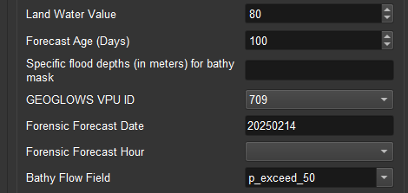
Let's Get Hands-On with NenCarta!
Land Water Value: The value of land cover designated as water in the land cover data. Currently, NenCarta only uses ESA WorldCover 2021, which designates water as a value of 80 in the land cover data.
Forecast Age: If specified, this requires Remove Old Forecast Files be check and it will delete any forecast outputs in the Watershed Name folder that are older than the date specified.
Specified flood depths (in meters) for bathy mask: This should be specified as a Python list, i.e., [0.1] or [0.1, 0.2]. This is used in conjunction with Clean DEM and Use Specified Depth for Bathy Mask. If Clean DEM is checked and so is Use Specified Depth for Bathy Mask, two values are required in this list. The first value will be used to create the water mask that is used to clean the DEM. The second value will be used by your selected Flood Mapper to burn ARC bathymetry into the DEM. If only Use Specified Depth for Bathy Mask is checked, this value will be used by your selected Flood Mapper to burn ARC bathymetry into the DEM.
GEOGLOWS VPU ID: This specifies the three-integer identifier for the GEOGLOWS VPU you are using (see https://training.geoglows.org/rfs/datasets/hydrography/#vpus). This value is required if you have checked the box Use Warning Flags to Download DEM.
Forensic Forecast Date: Specifying this value in a "YYYYMMDD" format will prompt NenCarta to attempt to access an archived GEOGLOWS or NWM forecast. This is for archived forecasts not reanalysis data.
Forensic Forecast Hour: If you enter a Forensic Forecast Date and are using the NWM, you must also enter a Forensic forecast hour as an integer value. The forecast hour must align with those available for each NWM forecast type.
Bathy Flow Field: This selection identifies the streamflow you will use to estimate a bathymetric profile in ARC. Your options vary based upon the Streamflow Source you have identified. All options specified in this dropdown are available to GEOGLOWS. Only the recurrence interval values (e.g., rp2) are available when you use the with the NWM as your Streamflow Source.
Note: Use the parameters in the image.

Slide 19
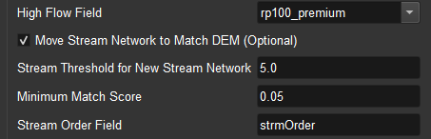
Let's Get Hands-On with NenCarta!
High Flow Field: This selection identifies the highest streamflow you will use when simulating in ARC. This value is intended to be a value that is representative of the highest flow that can occur for the modeling domain and is used by ARC to build the Curvefile or VDT Database that is used by your selected Flood Mapper to perform flood inundation modeling. Your options vary based upon the Streamflow Source you have identified. All options specified in this dropdown are available to GEOGLOWS. Only the recurrence interval values (e.g., rp2) are available when you use the with the NWM as your Streamflow Source.
Move Stream Network to Match DEM: If checked, this prompts NenCarta to use Whitebox tools to delineate flow direction, flow accumulation, and new hydrography using the DEM provided to NenCarta. The resulting streams are then conflated with the provided streamlines and their attributes are passed to the new network. The new network then becomes the streams used for flood mapping. This option is required when the Mapper Method is FLDPLNpy and optional for all other Mapper Methods.
Stream Threshold for New Stream Network: The upstream area, in square kilometers, that will be used to define the new stream network built with the provided DEM. This is required if Move Stream Network to Match DEM is checked.
Minimum Match Score: The float value that is used to determine if an adequate match is found when conflating the old stream network to a new DEM derived stream network. It represents the proportion of overlap between 50 meter buffers surrounding the old and new network. This is required if Move Stream Network to Match DEM is checked.
Stream Order Field: This is the field that is within the streamline shapefile. This is used as a filter in the Stream Order Lower and Stream Order Upper arguments and is required if those are specified.
Note: Use the parameters in the image.

Slide 20
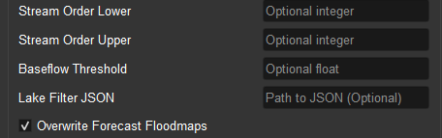
Let's Get Hands-On with NenCarta!
Stream Order Lower: Integer value that specifies that stream orders lower than this values will be filtered out of the analysis. So if the integer 3 is input here, streams that are stream order 1 and 2 will be removed from the analysis. This input requires the Stream Order Field argument.
Stream Order Upper: Integer value that specifies that stream orders higher than this values will be filtered out of the analysis. So if the integer 6 is input here, streams that are stream order 7+ will be removed from the analysis. This input requires the Stream Order Field argument.
Baseflow Threshold: Float value than can be used as an optional filter. If specified, streams that have a baseflow (specified by the Bathy Flow Field) less than this value will be filtered out of the analysis.
Lake Filter JSON: If you are using the GEOGLOWS data, you can pass an optional JSON file that designates if a stream is considered to be a lake. Specifying this will filter out those streams from the analysis.
Overwrite Forecast Floodmaps: If checked, all forecast outputs for the specified forecast date are overriden by NenCarta.
Note: Use the parameters in the image.

Slide 21
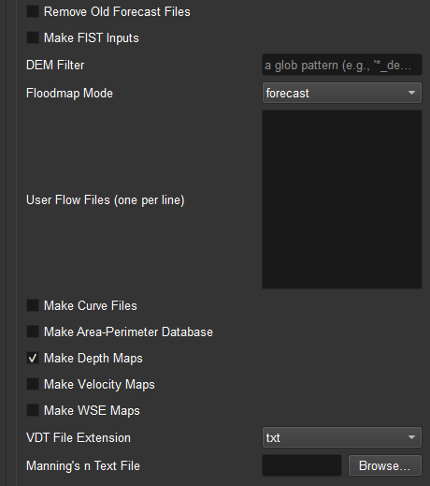
Let's Get Hands-On with NenCarta!
Remove Old Forecast Files: If checked, removes all forecast outputs that are older than the specified Forecast Age. Requires a valid Forecast Age.
Make FIST Inputs: If checked Flood Inundation Surface Toplogy (FIST) geojson inputs will be created for the forecast.
DEM Filter: Optional parameter that allows the user to select a DEM in the DEM Directory that will be used in the NenCarta run.
Floodmap Mode: There are two drop-down options here. The first option is "forecast" which will indicate that the simulation will use the most recent forecast from the streamflow source or the one specified as the forensic forecast. The second option is user that will allow you to model the flood inundation using the User Flow Files you specify.
User Flow Files: The text path (with no quotes) to multiple streamflow files that you wish to use for creating flood inundation maps. The stream IDs in these files must correspond to those that are in your stream flowlines.
Make Curve Files: Checking this box indicates that you want ARC to output curve files.
Make Area-Perimeter Database: Checking this box indicates that you want ARC to output area-perimeter database files. .
Make Depth Maps: Checking this box indicates that you want your Mapper Method to output depth rasters.
Make Velocity Maps: Checking this box indicates that you want your Mapper Method to output velocity rasters.
Make WSE Maps: Checking this box indicates that you want your Mapper Method to output water surface elevation rasters.
VDT File Extension: This selection allows you to specify the output type of your VDT file. The options are text, csv, and parquet files.
Manning's n Text File: Here you can browse to your own Manning's text file that describes the roughness values for the region. These values must align with the ESA WorldCover 2021 land cover values.
Note: Use the parameters in the image.

Slide 22
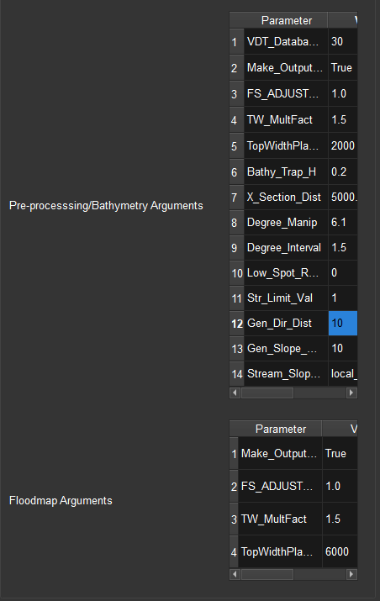
Let's Get Hands-On with NenCarta!
Pre-processing/Bathymetry Arguments: These are arguments you can change which pass to ARC and your Mapper Method when performing pre-processing and bathymetry estimation. See https://github.com/MikeFHS/automated-rating-curve/wiki/ARC-Input-File-Arguments and https://github.com/MikeFHS/curve2flood/wiki/Curve2Flood-Input-File-Arguments for more information on these arguments.
Floodmap Arguments: These are arguments you can change which pass to your Mapper Method when performing flood inundation mapping. See https://github.com/MikeFHS/automated-rating-curve/wiki/ARC-Input-File-Arguments and https://github.com/MikeFHS/curve2flood/wiki/Curve2Flood-Input-File-Arguments for more information on these arguments.
Note: Use the parameters in the image.

Slide 23
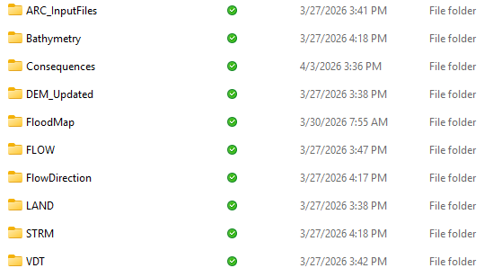
Let's Get Hands-On with NenCarta!
Here is what your Test1 folder will contain
ARC_InputFiles: The ARC and Curve2Flood input files.
Bathymetry: The ARC and Curve2Flood output rasters. GEOGLOWS_DEM_ARC_Bathy.tif is the bathymetry output by ARC. GEOGLOWS_DEM_FS_Bathy.tif is the bathymetry added to the DEM as an output from Curve2Flood.
Consequences: The directory includes the json input for go-consequences (GEOGLOWS_DEM_ARC_FloodDepth_Forecast_20250214_WGS84_consequences.json) and the geopackage output from go-consequences (GEOGLOWS_DEM_ARC_FloodDepth_Forecast_20250214_WGS84_consequences.gpkg).
DEM_Updated: Empty for our purposes.
FloodMap: Contains the flood mask used by Curve2Flood to burn ARC bathymetry into the DEM (GEOGLOWS_DEM_ARC_Flood_Initial.tif). Also contains the forecast flood inundation maps. GEOGLOWS_DEM_ARC_Flood_Forecast_20250214.tif is the ensemble flood inundation map. GEOGLOWS_DEM_ARC_Flood_Forecast_20250214.gpkg is a vectorized form of GEOGLOWS_DEM_ARC_Flood_Forecast_20250214.tif. GEOGLOWS_DEM_ARC_FloodDepth_Forecast_20250214.tif is depth grid that represents the maximum depth of the forecast.
FLOW: The reanalysis and forecast streamflow we used in ARC and Curve2Flood to create inputs and forecast flood inundation maps.
FlowDirection: These are the Whitebox tools outputs that were used to conflate the GEOGLOWS network with the DEM. DEM_flowdir.tif is the flow direction raster used by FLDPLNpy to map flood inundation.
LAND: The input land cover raster and Manning’s roughness used by ARC and Curve2Flood.
STRM: The stream raster used as input for ARC and Curve2Flood (GEOGLOWS_DEM_STRM_Raster_Clean.tif), along with the original stream network (GEOGLOWS_DEM_StrmShp.gpkg) and the modified stream network (DEM_flowlines_matched.gpkg).
VDT: The rating curve (GEOGLOWS_DEM_CurveFile_Bathy.csv) and velocity, depth, top-width (VDT) database (GEOGLOWS_DEM_VDT_Database_Bathy.txt) output by ARC used by Curve2Flood to perform flood inundation mapping. We used the VDT database in this instance.

Slide 24
Let's Get Hands-On with NenCarta!
How does your flood map and consequences look? Open them in your preferred GIS software (QGIS, Arc Pro) and take a look!

Slide 25
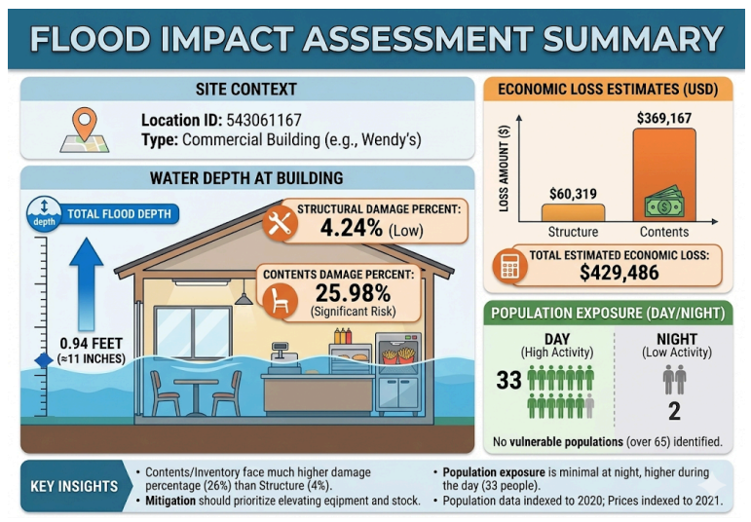
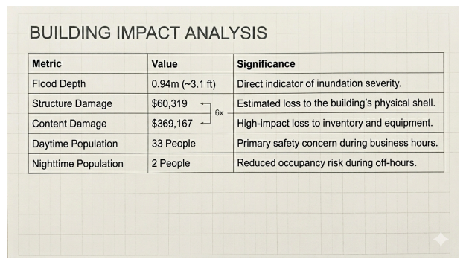
Visualization Considerations
According to best practice, we would recommend not using the flood impact forecast in its raw format but, instead, transforming it into a more user-friendly artifact. Something like the table or infographic here would be a better summary and visualization.
What are your thoughts on how visualizations of the flood impact forecast could occur? Feel free to share or demonstrate your thoughts with the outputs of our test simulation.
These are test visualizations and summaries of the previously demonstrated Wendy’s example that the University of Minnesota developed as suggestions for visualizing a locations individual flood damages.

Slide 26
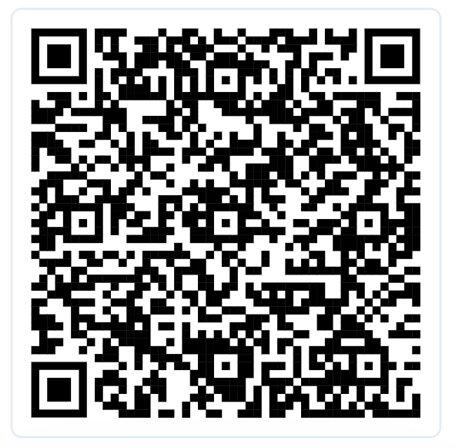
Feedback Survey
The questions should help us gauge you envision using this product and how you understand it.
The survey should take 2-3 minutes to fill out and is anonymous.
Link to survey: https://docs.google.com/forms/d/1GX0mXSZ9N5PsDBP7aM6tvfhVm_5HMh-hycz-QNSAkFw/edit

Slide 27
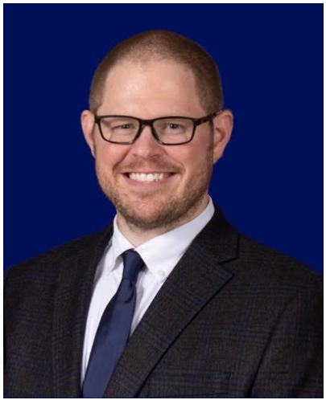

Thank you!
Joseph Gutenson, PhD
^{Follum Hydrologic Solutions}
^{joseph@follumhydro.com}
Mike Follum, PE, PhD
^{Follum Hydrologic Solutions}
^{mike@follumhydro.com}

