Slide 1
Why and How to Use Economics to Evaluate Forecasts and Value Their Impacts
Presented by:
George Van Houtven (RTI)
Daniel Lapidus (RTI)
Presented at:
CIROH Developers Conference
May 27, 2026
Salt Lake City, Utah

Slide 2
Outline of Workshop
Background:
  Types of economic analyses of public sector decisions
  Econ analysis requirements and practices by fed agencies (including NOAA)
  Economic analysis of structural flood control investments (dams) vs. non-structural flood control investments (flood forecast systems)
Conceptual framework for valuing streamflow forecast information
  Value of information (VOI) framework and the cost-loss model
Example Applications
  Simple stylized 2x2 flood forecast example
  Real world flood forecast example (Upper Mississippi River)
  Real world drought low-flow forecast example (Lower Mississippi River)
  Forecast-informed reservoir operations (FIRO) example

Slide 3
Types of Economic Analyses for Public Sector Decision
Positive vs normative analysis
  What percentage of households will drop their flood insurance policies if their premiums increase?
  Is it a good idea for the government to subsidize flood insurance premiums?
Benefit-cost analysis (BCA) vs Economic impact analysis (EIA)
  BCA evaluates the net societal value of public sector actions by identifying, quantifying, monetizing (to the extent feasible), and comparing their positive and negative impacts on society
  EIA evaluates their impacts on the regional or national economy, through measures such as changes in household incomes, employment, profits, tax revenue, sales revenues, etc
Prospective vs retrospective analysis
Notes:
Positive : Describe and predict behavior: how do people respond to incentives?
Normative: Understand the tradeoffs of involved in alternative public actions to decide which is best

Slide 4
General BCA Requirements and Practices for Federal Agencies
E.O. 12866: “Regulatory Planning and Review”
  Requires detailed CBA for “significant regulatory actions” by the federal government
E.O. 12893: “Principles for Federal Infrastructure Investments”
  Requires federal government to undertake “systematic analysis of expected benefits and costs” of infrastructure investments
  States that “benefits and costs should be quantified and monetized to the maximum extent practicable”
  Affected investments include “direct spending and grants for transportation, water resources, energy, and environmental protection.”
  Office of Management and Budget (OMB) provides guidance on implementation of CBA for infrastructure investments
Notes:
quantify, and monetize

Slide 5
BCA Practices by Federal Agencies Applied to Flood Control
USACE
Since Flood Control Act of 1936, CBA has been a core component of planning and justifying flood management projects under its Civil Works program. It has widely used CBA to assess the net benefits of flood control infrastructure projects, such as reservoirs levees floodwalls seawalls.
FEMA
For projects seeking funding under its Flood Mitigation Assistance program, FEMA requires applicants to demonstrate that project benefits exceed costs. Applicants must use FEMA-approved methods and BCA Toolkit (FEMA BCA Toolkit) to justify projects such as elevation of structures flood proofing stormwater basins property acquisition
EPA
EPA routinely uses CBA to assess the net benefits of its proposed “economically significant” regulations, (as required by E.O. 12866) Assessments of EPA stormwater management regulations often involve estimating the costs and flood control benefits of grey and/or green infrastructure approaches
NOAA
NOAA does not have agency-specific requirements for CBA, but activities by its Line Offices can trigger federal CBA requirements (Benefit-Cost Analysis: Practitioners Guidance for NOAA's Programs) One example is a CBA for the procurement of G550 aircraft to support NOAA’s hurricane forecasting capability

Slide 6
NOAA Guidance on BCA
Benefit-Cost Analysis: Practitioners Guidance for NOAA's Programs
“…provides the fundamentals of the BCA methods that can easily be adapted to the needs of various NOAA Line Offices and programs desiring to compare benefits and costs of their projects as part of their decision making process… For instance, the guidance can be adapted to specific non-regulatory projects, such as investments in green infrastructure, or projects on nature-based solutions that can reduce the impacts of coastal hazards.”

Slide 7
Benefits of Flood Control Projects: Types of Avoided Damages/Losses
 | Tangible direct losses | Tangible indirect losses | Intangible human and other losses
Primary | Damage to Building structures Building contents Public infrastructure (e.g. roads, bridges) Crops and livestock | Loss of, or disruption to: Ag production Industrial production Communications and connectivity (e.g. road, rail and telecommunications) Health care and education services Utility supplies (e.g. electricity) | Loss of life Physical injury Loss of heritage or archaeological sites Loss to natural environment Loss to recreation
Secondary & Tertiary | Flood-caused fire damage Debris accumulation Soil erosion Contamination of land and water supplies | Loss of income and productivity in affected sectors Increased traffic congestion costs Food and other shortages Ripple effects in “downstream” economic sectors | Psychological stress and trauma Illnesses related to flood hazards Increased homelessness Displacement and disconnection of communities

Slide 8
Tools for Estimating Benefits of Flood Control Projects
FEMA’s HAZUS Hazus | FEMA.gov
USACE HEC-FDA
Existing tools are primarily designed and used for estimating the benefits of structural flood control measures
  Dams and Reservoirs
  Levees and Floodwalls
  River Channelization and Diversions
  Urban Drainage Systems
  Green Infrastructure
Limited focus on how human decisions and behaviors are affected by the flood control measures
  Decisions and behaviors are central to the benefits of non-structural information-based approaches such as flood forecasts and early warning systems

Slide 9
Pre-flood Protective (precautionary, temporary, advance, emergency, damage-avoidance, mitigation) Measures
Types of measures | Types of decision makers | Types of costs
install temporary barriers remove property from flood-risk areas evacuate people redirect traffic empty reservoirs preposition emergency resources cancel gatherings and other activities in flood zone remove debris or hazardous materials form flood-risk areas install temporary pumps disconnect appliances etc issue warnings and other risk communication | residents businesses emergency managers reservoir operators | equipment, materials labor and other time costs disruption of productive or valued activities opportunity cost of reservoir storage flood damage from advance reservoir releases

Slide 10
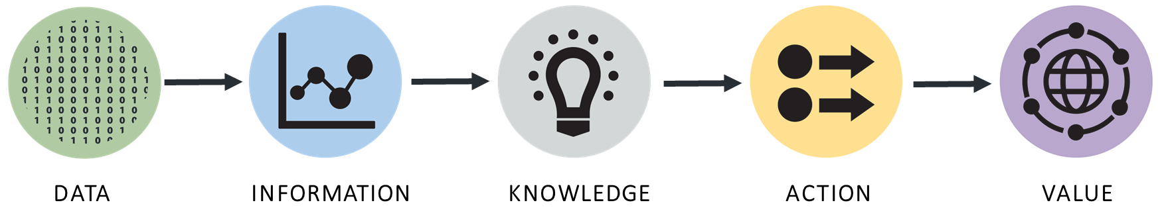
Conceptual Framework for Valuing Information: Value Chain

Slide 11
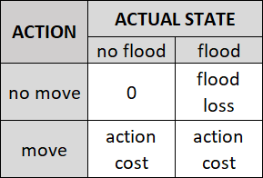
Conceptual Framework: Value-of-Information (“cost-loss”)
Determinants
x
UPSTREAM RAIN
x
x
Predicted State
f (x)
FLOOD or NO FLOOD
Uncertain State of Nature
s(x)
FLOOD or NO FLOOD
Forecast Model
p(s|f)
s
Action
a(f)
MOVE or NO MOVE
Outcome
o(a, s)
PHYSICAL DAMAGE
MOVING COSTS
a
Decision Model
Outcome Model
o
PAYOFF MATRIX
maximize expected value
Value
v (o) = v(a, s)
COST+LOSS VALUE
Valuation Model

Slide 12
Decision Model: Expected Value (EV) Maximization
A simple and commonly used model of decision-making under uncertainty
Assumes that decision makers, when faced with different action options, choose the action that provides the highest expected (i.e., probability weighted) value
Imagine there are 2 possible and mutually exclusive outcomes (e.g., win or lose) and we know the value of those outcomes ($win, $lose), but we don’t know for certain which one will occur.
Imagine there are many possible actions (a_{i} = a₁, a₂ , a₃,…OR a_{N} ), each of which affects the probability of each of outcome
The Expected Value (EV) of an action a_{i}
= probability of outcome 1 with action a_{i} x value of outcome 1
+ probability of outcome 2 with action a_{i} x value of outcome 2
= Pwin_{i} x $win + Plose_{i} x $lose
= Pwin_{i} x $win + (1- Pwin_{i}) x $lose

Slide 13
Example 1: 2x2 Cost-Loss Model of Flood Forecast VOI
A city located along a large river experiences a rainy season every April
Over the last century, the river has flooded on average once every ten years during the rainy season
For $1 million per year, the city can purchase a forecast system that in March will provide a flood prediction (FLOOD vs NO FLOOD) for April
The accuracy of the forecast system is known, based on other cities’ experience with the same system
Some of the physical property located along the river can be protected from flood damage by moving it to higher ground in early April, so every year, before April, the town must decide what to do (MOVE vs NO MOVE).
The city knows how much it will cost to move the property (C)
It also knows the value of flood damages that will be avoided by moving property (i.e., avoidable flood loss = La)
It also knows that some property cannot be moved and will incur damages if flooding occurs (i.e., unavoidable flood loss = Lu)
Flooding never causes deaths or physical injuries
Based on what it knows about the forecast system and about the costs and losses, should it purchase the forecast system?

Slide 14
Questions
What would this year’s expected cost+loss (outcome value) be if the town did NOT buy the forecast system?
What would this year’s expected cost+loss (outcome value) be if the town DID buy the forecast system?
What is the most the town should be willing to pay this year for the forecast system (i.e., what is the forecast VOI)?
What would the value of a PERFECT forecast be?
What would happen to the forecast VOI if the avoidable loss (La) were higher or lower?
What would happen to the forecast VOI if the unavoidable loss (Lu) were higher or lower?
What would happen to the forecast VOI if the response cost (C) were higher or lower?
How bad does an IMPERFECT forecast have to be to have ZERO value?
What is the relative economic value (REV) of the imperfect forecast system?

Slide 15
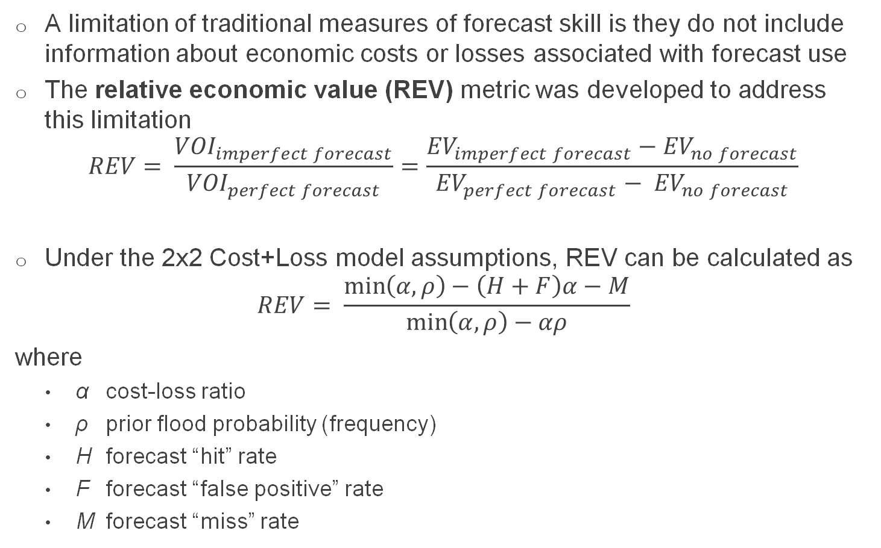
Incorporating Economic Value into a Forecast Evaluation Metric
A limitation of traditional measures of forecast skill is they do not include information about economic costs or losses associated with forecast use
The relative economic value (REV) metric was developed to address this limitation
$$REV= \frac{{VOI}_{imperfect forecast}}{{VOI}_{perfect forecast}}=\frac{{EV}_{imperfect forecast}−{EV}_{no forecast}}{{EV}_{perfect forecast}− {EV}_{no forecast}}$$
Under the 2x2 Cost+Loss model assumptions, REV can be calculated as
$$REV= \frac{\min\left(α,ρ\right)−\left(H+F\right)α−M}{\min\left(α,ρ\right)−αρ}$$
where
  α cost-loss ratio
  ρ prior flood probability (frequency)
  H forecast “hit” rate
  F forecast “false positive” rate
  M forecast “miss” rate
See Laugesen et al (2023)
for expanded REV

Slide 16
Graphical Representation of Results

Slide 17
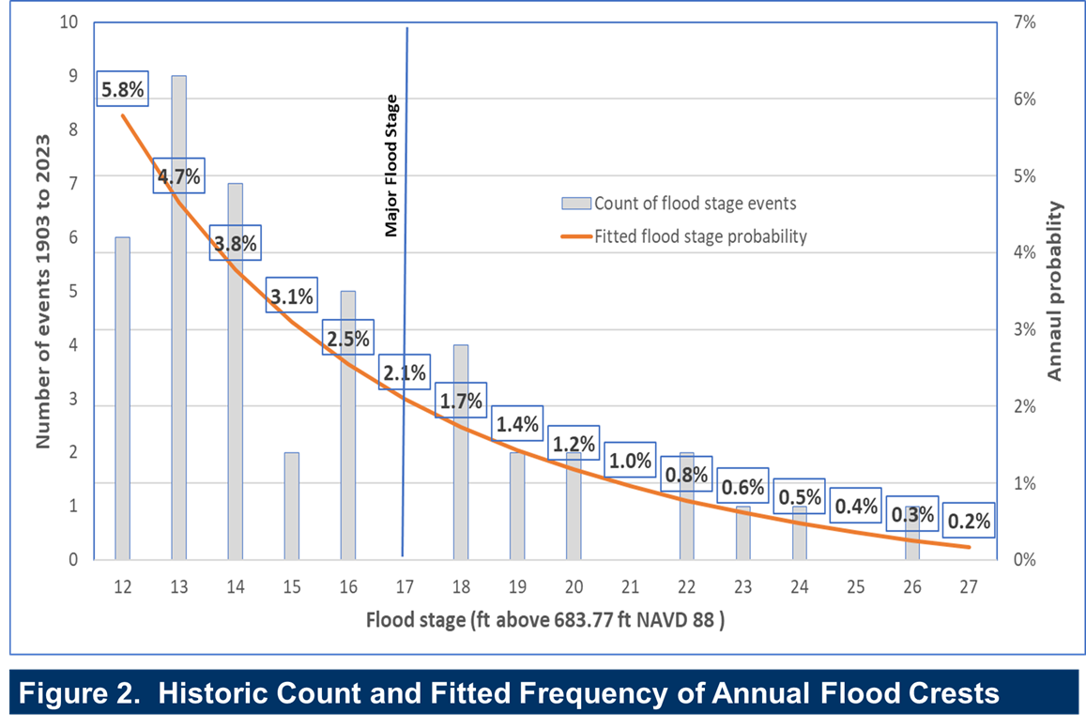
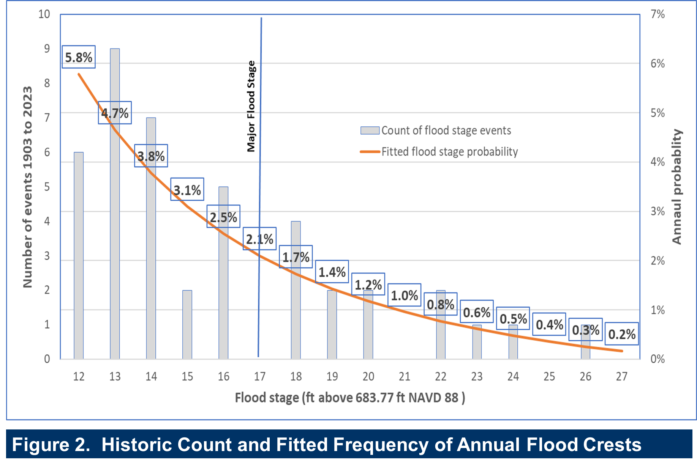
Example 2: Mississippi River Flood Forecast for St Paul, MN

Slide 18
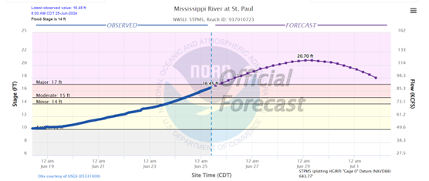
City of St Paul Flood Management
Flood Forecast System: The city relies on several forecast products from the North Central River Forecast Center (NCRFC), most importantly a deterministic 7-day forecast for the Mississippi River at St. Paul
Temporary Protective Measures: The city has a flood action plan matrix that lists specific actions for different forecasted flood levels, including:
  Installing temporary flood barriers
  Relocating moveable property
  Limiting access to expected flood areas (e.g., road closures)
  Communicating flood warnings and recommendations to the public

Slide 19
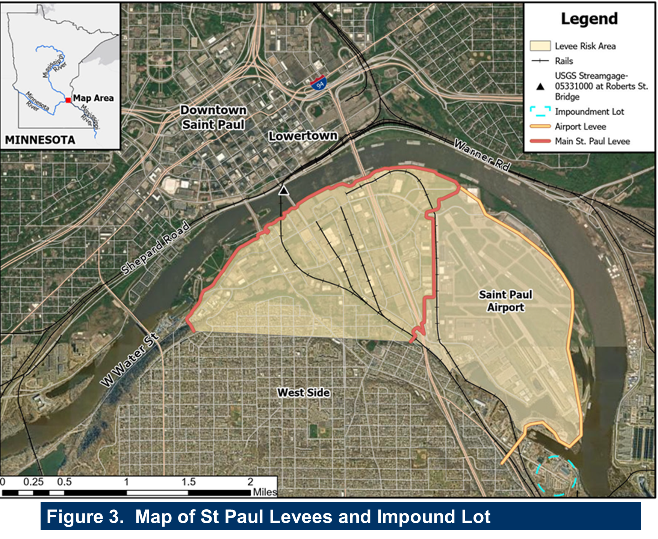
Case Study Includes Three Main Types of Protective Measures
Temporary barriers in St. Paul Levee (4 action levels)
Temporary barriers in Airport Levee (2 action levels)
Relocation of vehicles in the city’s impound lot (2 action levels)

Slide 20
Payoff Matrixes for Selected Protective Actions
St Paul Levee (Cost + Loss in $’000)
Airport Levee (Cost + Loss in $’000)
Impound Lot (Cost + Loss in $’000)

Slide 21
Results: Value of Perfect Forecast Information ($’000 per year)
 | Expected value of outcomes (cost+loss)
Emergency protective measure | Perfect forecast (a) | Without- forecast Case 1 (b) | Without- forecast Case 2 (c) | Without- forecast Case 3 (d)
St Paul levee | -16 | -6,127 | -429 | -185
Airport levee | -146 | -967 | -456 | -202
Impound lot | -6 | -75 | -75 | -43
Value of perfect forecast
Case 1 (a) – (b) | Case 2 (a) – (c) | Case 3 (a) – (d)
6,112 | 414 | 169
821 | 310 | 55
69 | 69 | 37
Alternative “Without-forecast” Scenario Assumptions
  Case 1: Never take protective actions
  Case 2: Always (every year) choose action with highest expected value, based on prior flood probabilities (historic flood frequency)
  Case 3: Select most protective action every time flood stage reaches 10 ft

Slide 22
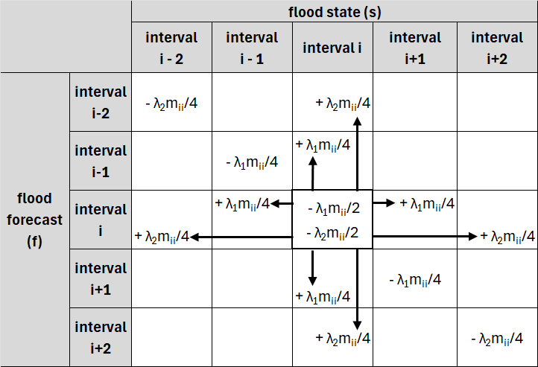
Imperfect Forecast: Simulation of forecast error in the contingency matrix

Slide 23
Value of Imperfect Forecast Information: Sensitivity Analysis with Simulated Forecast Errors (and Case 3 Counterfactual)
 | Simulated forecast error
Emergency protective measure | λ₁= 0 λ₂ = 0 | λ₁= 0.05 λ₂ = 0 | λ₁= 0.1 λ₂ = 0.05 | λ₁= 0.2 λ₂ = 0.1
St Paul levee | $169,414 | $164,545 | $158,596 | $158,596
Airport levee | $55,494 | $53,227 | $50,040 | $49,013
Impound lot | $36,751 | $36,703 | $36,555 | $36,359
Forecast error parameters
  λ₁ : fraction of forecast with ±1 foot error
  λ₂ : fraction of forecast with ±2 foot error

Slide 24
Key Conclusions
Analysis demonstrates that the VOI framework can be applied in a multi-dimensional real-world context
  Value of a perfect forecast for the city would be roughly $260,000 per year for the 3 selected protective measures
  Including simulated forecast errors reduces this value by at most 12 percent
Challenges and limitations:
  Costs of temporary protective measures can be highly variable, depending on duration, time of year, and advance notice of flooding
  Includes limited estimates of business disruption costs from actions or flooding
  Does not address dynamic nature of protective action decisions (i.e., whether to wait for more forecast information)
  VOI estimates depend importantly on how without-forecast scenario is specified

Slide 25
Example 3: Low-Flow Forecasts for Lower Mississippi River
Over the last several years, the lower Mississippi River has experienced extreme, record-breaking low water levels.
The river transportation industry is one of the most directly and heavily impacted. They rely on NOAA’s low-flow forecasts to make decisions about how much cargo they carry (and whether cargo restrictions need to be put in place).
Restrictions can substantially increase the costs to the river transportation industry, but also the sectors that are transporting goods (e.g. agriculture, petrochemicals, natural gas, minerals).
The value of the forecast to the transportation industry are the avoided costs of the actions they take (e.g. imposing restrictions) compared to the what would have happened without the forecast (e.g. imposing stricter restrictions or not taking action and running aground).
Without the forecast, costs will be higher but how much higher? With a better forecast, costs will be lower but how much lower?

Slide 26
Payoff Matrix for Barge Restriction Decisions Under Low-flow Uncertainty
 |  | ACTUAL STATE
 |  | Normal-to-high flows | Low flows
ACTION | Do not announce barge restrictions | no deviation from normal barge traffic | barges grounded, stalled, or returned for lightering
 | Announce barge draft and width restrictions | fewer tons transported per barge group | fewer tons transported per barge group

Slide 27
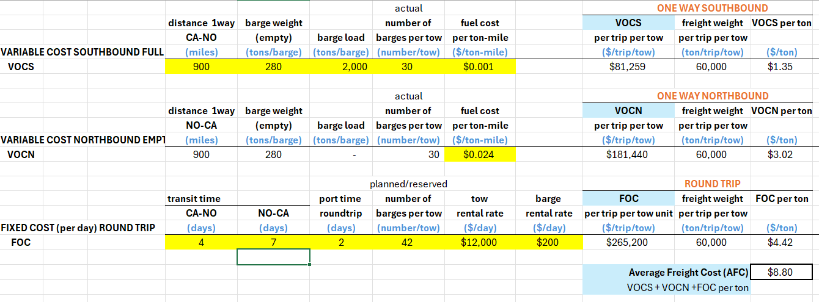
We developed a cost model to simulate the impact of low flow restrictions on river transportation costs

Slide 28
The difference between the actual river stage and the restriction visually represents money being “left on the table”.
Notes:
Comparing to observed conditions (i.e., perfect forecasts) allows us to estimate the upper bound on the value of improving forecasts from current conditions, but what about just the value of the current forecast? Still need to specify: Compared to what?

Slide 29
Example 4: Forecast-Informed Reservoir Operations (FIRO)
Forecast: Short-term (daily) and long-term (seasonal) inflows to reservoir
Decision: Daily Spring and Summer water releases from reservoir
  Counterfactual: reservoir guide curve (independent of forecast)
  Forecast-informed decision rule
  Forecast-informed maximization of values provided by reservoir water
Outcomes of interest:
  Seasonal agricultural water supply storage
  Downstream flood risks and impacts
  Hydropower generation (depend on release size and head height)
  Water-based recreation at the lake
Values of interest:
  Profits earned by downstream irrigators
  Downstream flood damages/losses
  Profits earned by hydropower
  Total consumer surplus experienced by recreators

Slide 30
Payoff Matrix for Reservoir Release Decisions Under Inflow Uncertainty
 |  | ACTUAL STATE
 |  | Low Spring inflow | High Spring inflow
ACTION | Low rate of water release in Spring | - medium water supply storage for summer irrigation - low generation but medium head for hydropower - good water level for summer lake recreation - no flooding | - high water supply storage for summer irrigation - low generation but high head for hydropower - too high water level for summer lake recreation - major downstream flooding
 | High rate of water release in Spring | - low water supply storage for summer irrigation - high generation but low head for hydropower - too low water level for summer lake recreation - minor downstream flooding | - medium water supply storage for summer irrigation - high generation and medium head for hydropower - good water level for summer lake recreation - minor downstream flooding

Slide 31
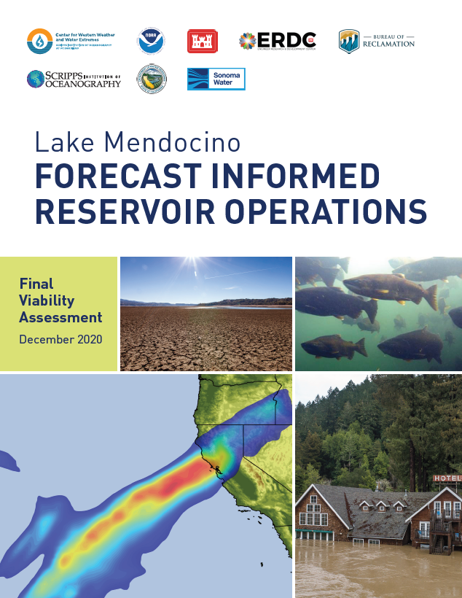
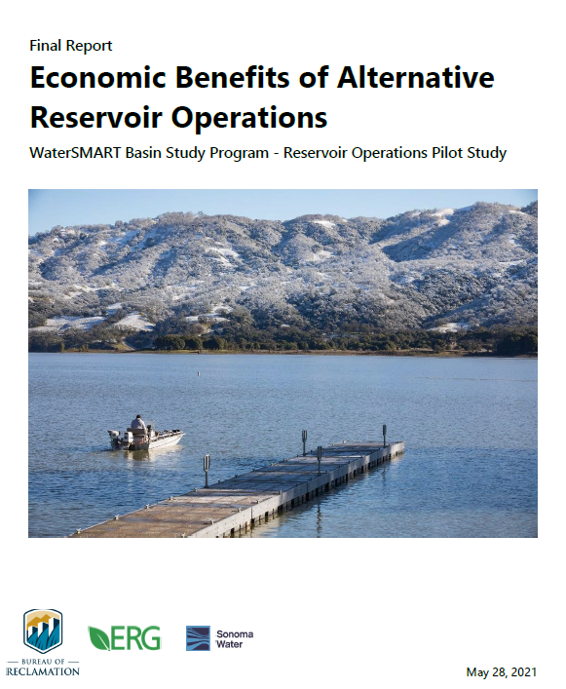
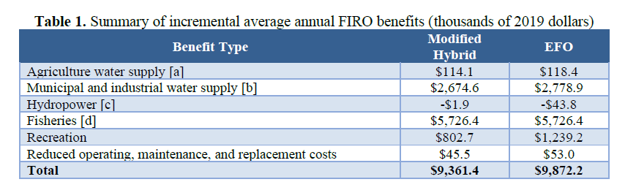
Lake Mendocino FIRO Viability Study

Slide 32
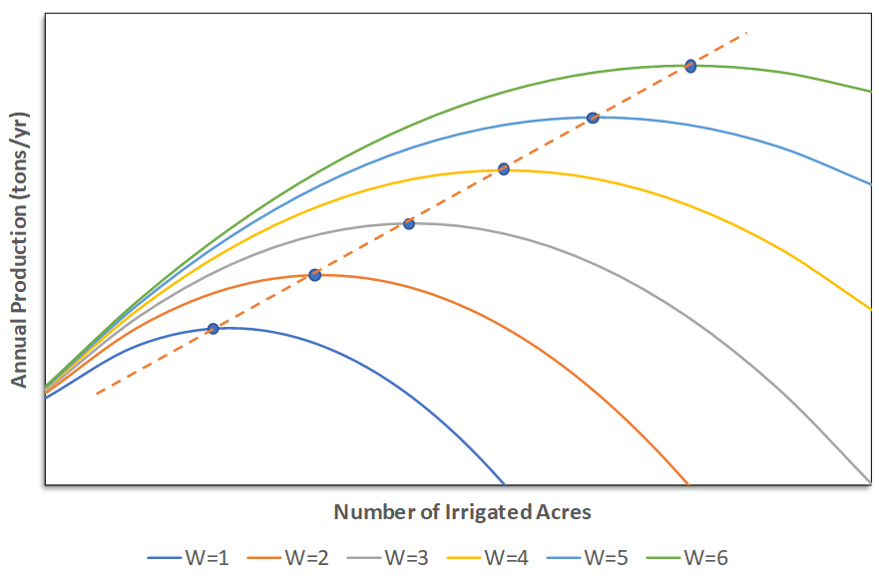
Example 5: Seasonal Water Supply Forecasts for CO Farmers
Decision: Number of Planted/Irrigated Acres
Actual water supply:
“Revealed Preference” Regression Analysis:
Ag output = a + b(Actual water supply) - c(Forecast error) + d(Other)

